Slide 1
Airbnb Listing Dataset

Slide 2
Dataset Details
Airbnb, inc. Is an american company, which was founded in 2008.
Airbnb operates an online marketplace for short- and long-term home stays and experiences.
This dataset describes the latest listing activity in new york city, new york as of january 5th, 2024. It is published originally by the company itself so it is authentic and reliable.
This dataset contains all the information needed about the new york airbnb listings.
This version of dataset is taken from kaggle which is modified version of original published on website by removing null values.
Its size is 4.44 MB and contains 20759 records.

Slide 3
Description OF DATASET
Dataset relevant features includes
No of bedrooms , no of beds, no of baths, availability_365, no_of_reviews and prices.
Set of Hypothesis :
Pricing-Related Hypotheses:
H1: The number of bedrooms, beds, and baths positively correlates with the price
Demand & Availability Hypotheses
H2: Listings with more reviews have higher availability.

Slide 4
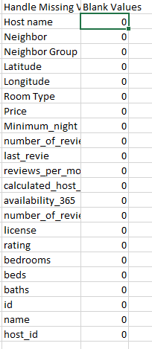
Data CLEANING
Missing values: no missing values were detected.

Slide 5
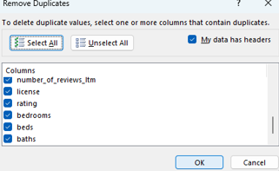
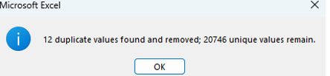
Data CLEANING
Duplicate Values:

Slide 6
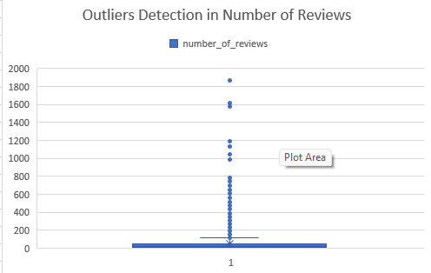
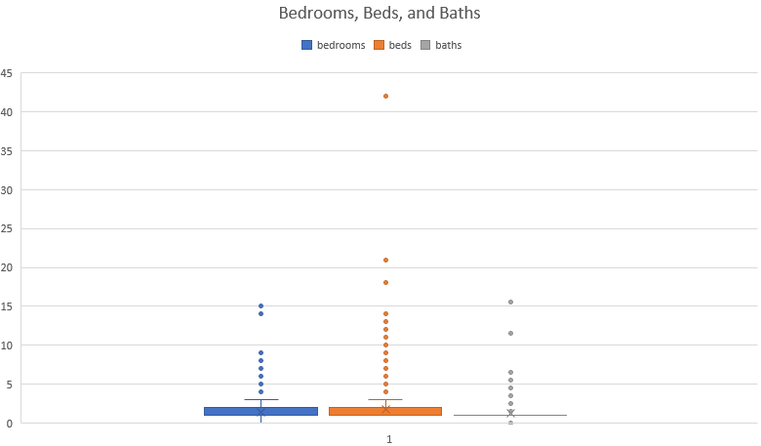
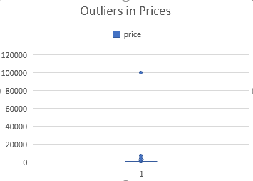
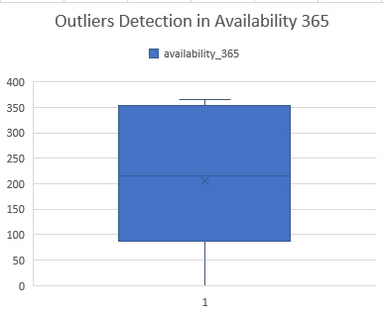
Data Outliers
Before removing outliers

Slide 7
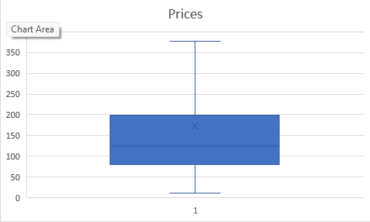
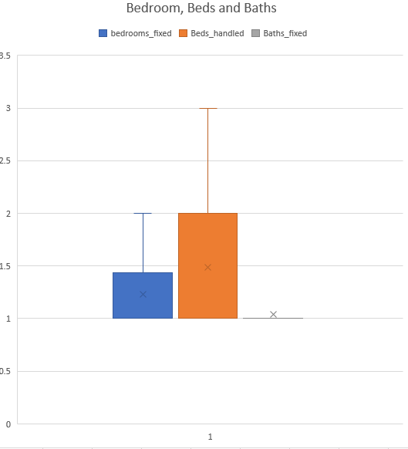
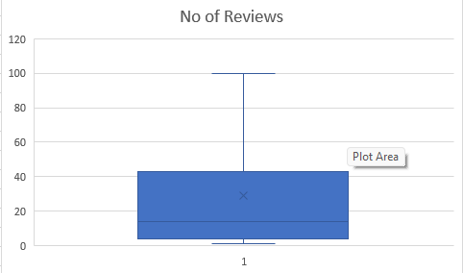
Data Outliers
After applying fix:

Slide 8
NOISE IRREGULARITY
Further to check if any column contains NA or null values. I have applied filters on each column and check the range of values that can be found in each of these columns.
Most of the column contains no n/a null or blank values.
Some variable like for no license there are total 17000+ records, so we neither eliminate them nor replace it with something else.
There were 13 records in bath column which are not specified and removed in earlier steps.

Slide 9
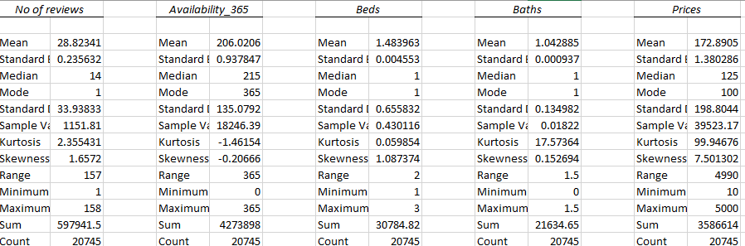
DESCRIPTIVE STATS
Using both measure of central tendency and spread of data.

Slide 10
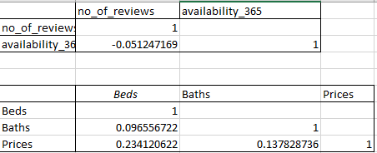
CORRELATION

Slide 11
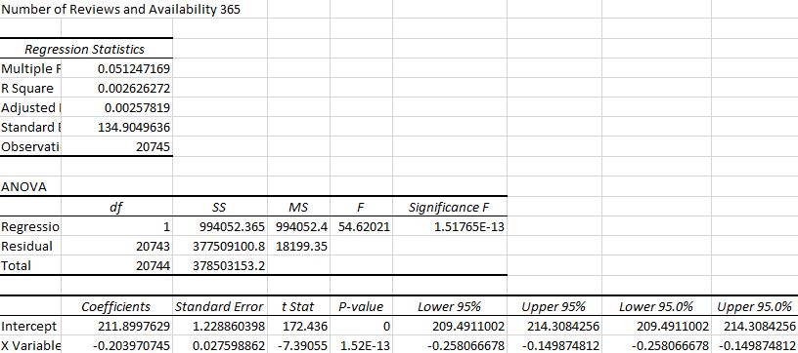
REGRESSION

Slide 12
Relationship Between availability and Reviews
No of reviews and availability.
R Square: 0.0026 → Extremely low, less than 1% of the price variation explained
Coefficient: -0.203 → A negative relationship: more reviews or higher availability correlates with slightly lower prices.
P-value: ≈ 1.52e-13 → Statistically significant but weak effect
Conclusion:
Although the result is statistically significant, the practical impact is minimal. More reviews and availability slightly reduce prices, possibly indicating higher competition or lower quality.

Slide 13
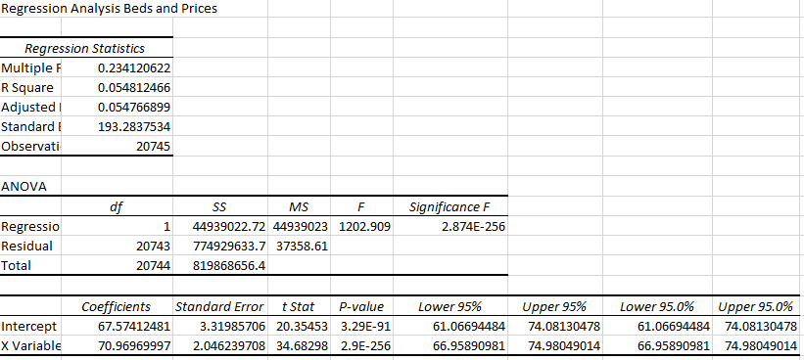
REGRESSION

Slide 14
Relationship Between BEDS AND Prices
Beds and prices
R square: 0.0548 → about 5.5% of the variation in prices is explained by the number of beds.
Coefficient: 70.97 → each additional bed increases the price by approximately $71.
P-value: very low (≈ 2.9e-256) → statistically significant.
Conclusion:
There’s a positive and significant relationship between the number of beds and prices, though the model explains a small portion of the price variation.

Slide 15
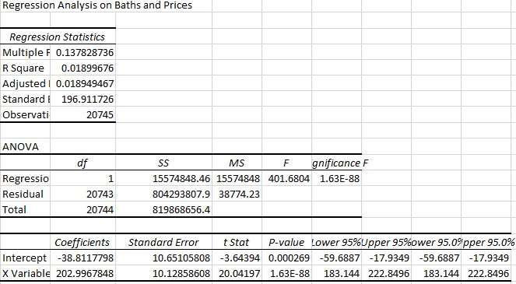
REGRESSION

Slide 16
Relationship Between BATHS AND PRICEs
Baths and prices
R Square: 0.01899 → Only 1.9% of price variation is explained by number of baths.
Coefficient: 202.99 → Each additional bath increases the price by approximately $203
P-value: Very low (≈ 1.63e-88) → Statistically significant.
Conclusion:
Baths have a stronger per-unit impact on price than beds, but still explain only a small amount of overall variance

Slide 17
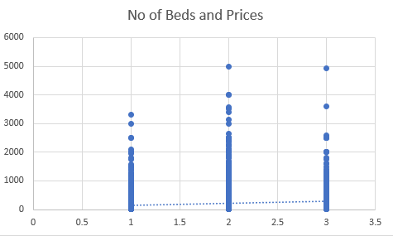
VISUAL REPRESENTATION

Slide 18
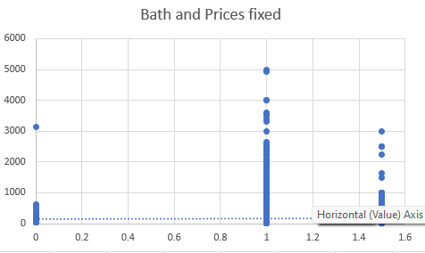
VISUAL REPRESENTATION

Slide 19
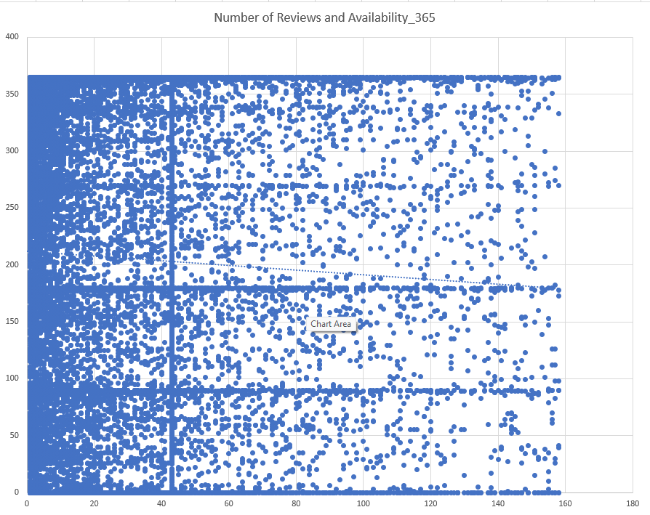
VISUAL REPRESENTATION

Slide 20
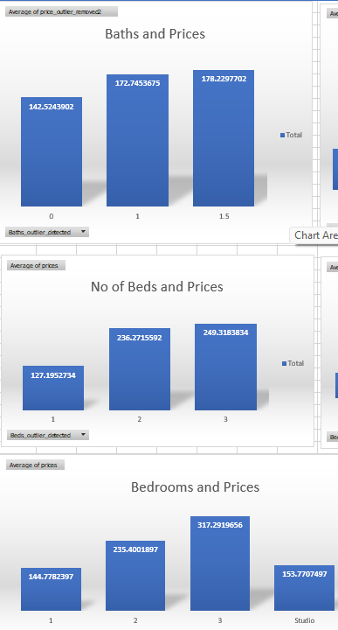
DASHBOARD
Analyzed the direct relationship of no of bedrooms, no of beds and no of baths on price

Slide 21
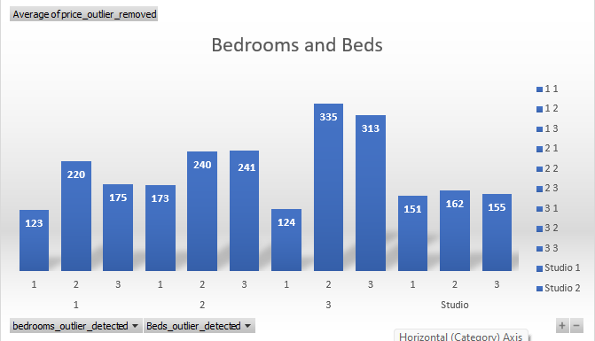
DASHBOARD
Analyzed the impact of combined variables like bedrooms and beds on pricing.

Slide 22
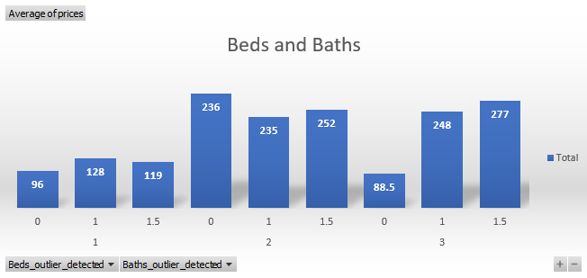
DASHBOARD
Analyzed the impact of combined variables like bedrooms and baths on pricing.

Slide 23
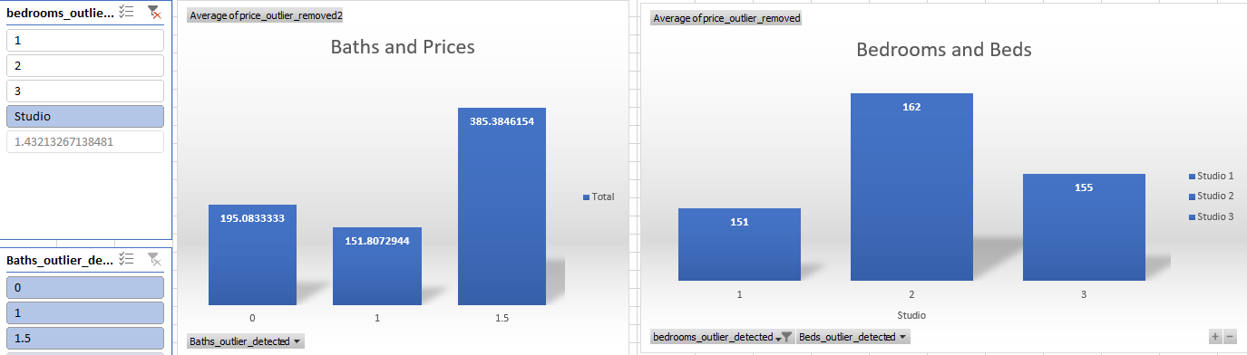
DASHBOARD
Statistics for a studio

